Slide 1
2018.12.27

Slide 2
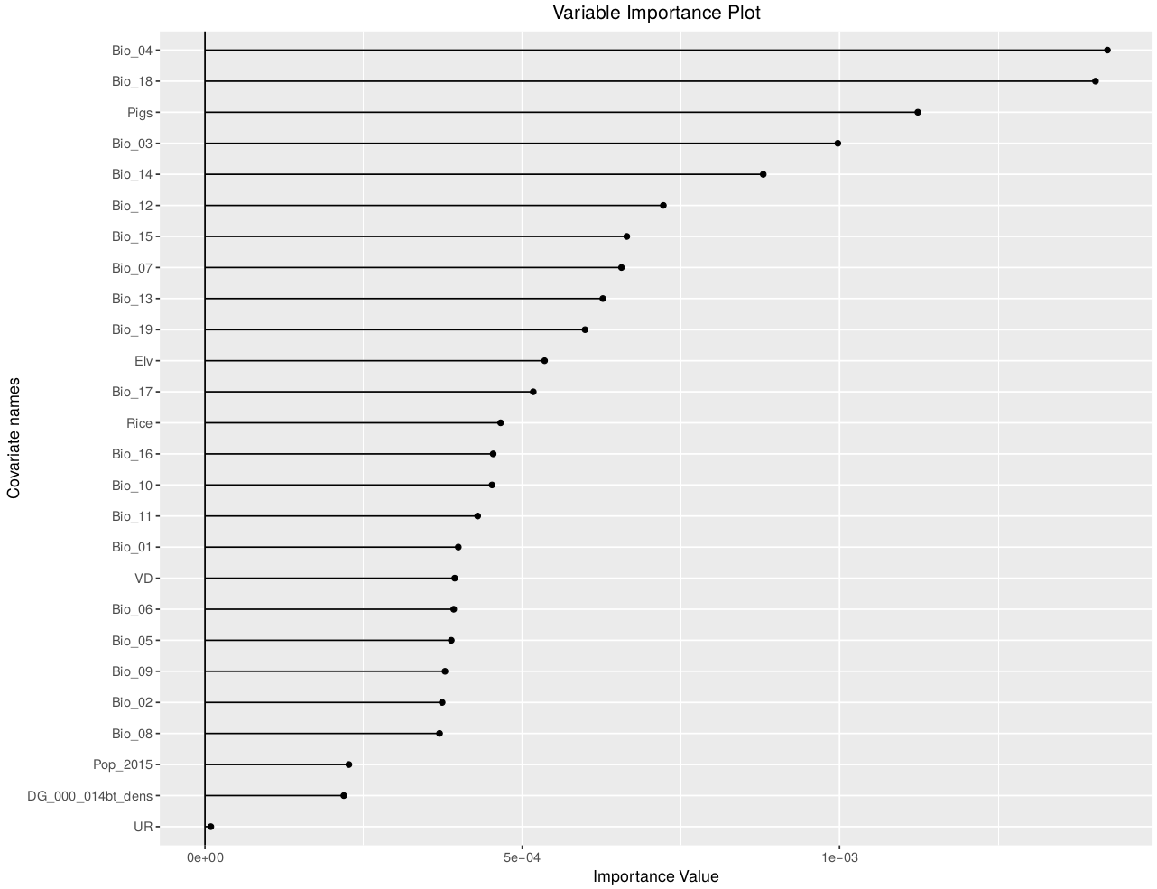
Full Covariate – Bioclimatic – Pixel sampling

Slide 3
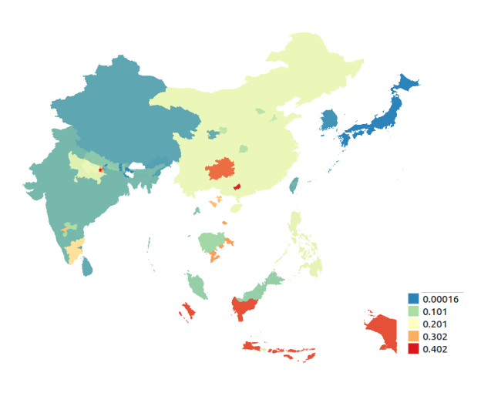
Simple mapping

Slide 4
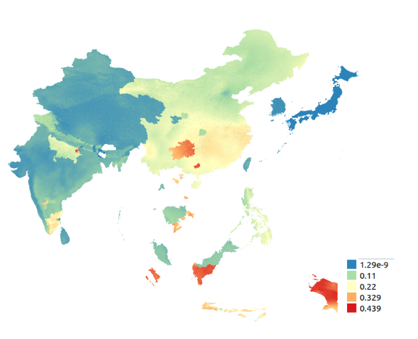
EM Mapping

Slide 5
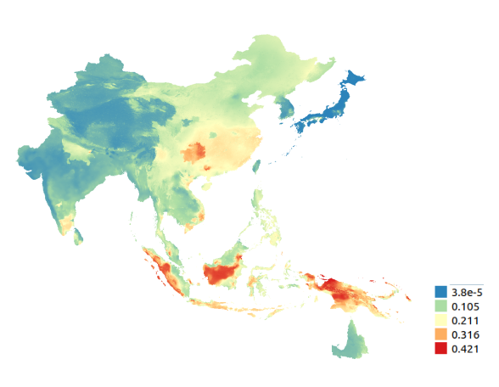
Bioclimatic – Pixel sampling

Slide 6
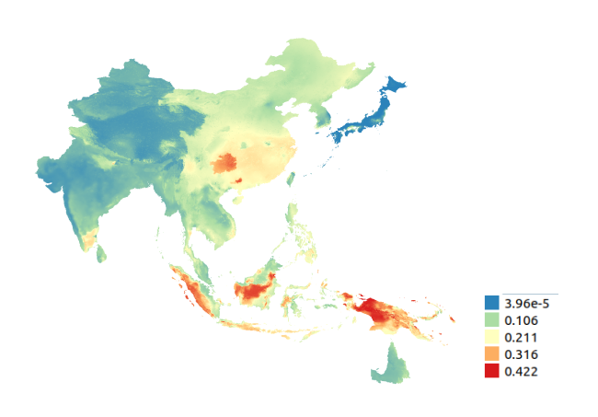
Bioclimatic – Region sampling

Slide 7
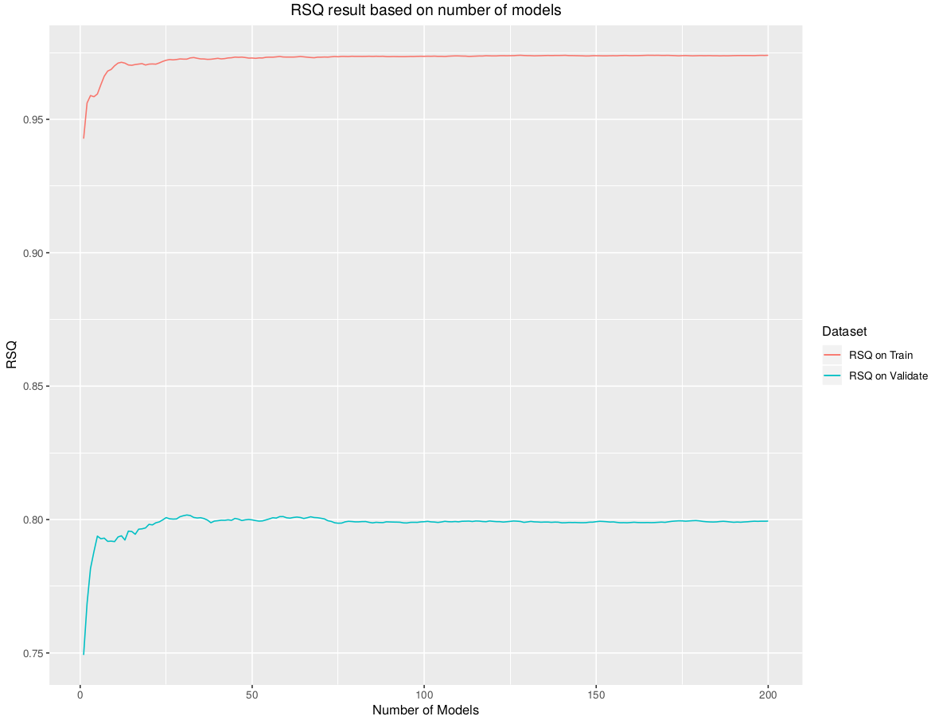
Bioclimatic – Rsq on number of models (RegionTVT)

Slide 8
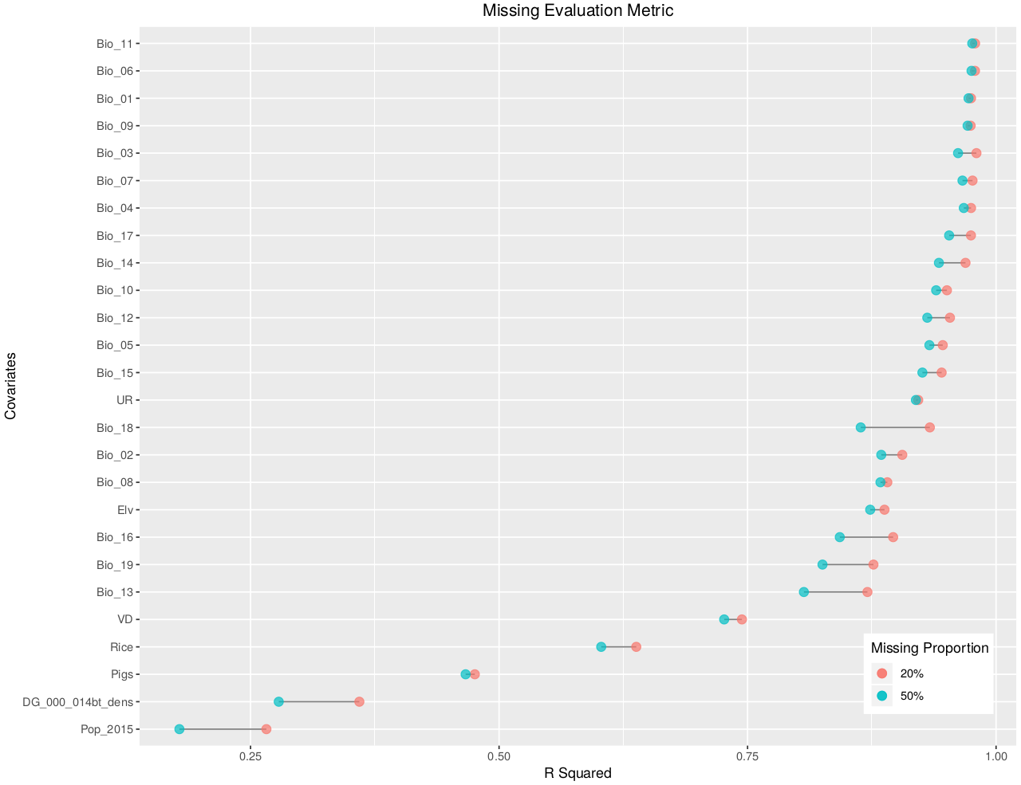
Missing value impute rsq

Slide 9
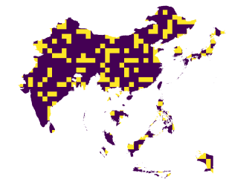
Sampling by grid

